Slide 1
Retail in 2020
By John Dornoff
City of Waterloo, Iowa

Slide 2
The retail apocalypse and the future of retail

Slide 3
Was it really because of Amazon?

Slide 4
What are we going to discuss today?
Early History of Retail
From late 1880’s till 1960’s
1962
1990’s to 2019
The Year of COVID
What is the future of retail?

Slide 5
Early Retail History
Photo by Zello

Slide 6
Early Retail History

Slide 7
Late 18th Century to 1962
From the Bell & Arnot Collection in the Town of Champion Archives

Slide 8
Late 18th Century to 1962
Unknown Source

Slide 9
Late 18th Century to 1962
Unknown Source

Slide 10
Late 18th Century to 1962
DeGolyer Library, Southern Methodist University

Slide 11
Late 18th Century to 1962
Unknown Source

Slide 12
Late 18th Century to 1962
Photo Courtesy of Betty Sanders, Demopolis, Alabama

Slide 13
Late 18th Century to 1962
Unknown Source

Slide 14
1962
NASA photo

Slide 15
1962
Photo from Milwaukee Library

Slide 16
1962
Photo from Kmart

Slide 17
1962
Photo from Pleasant Valley Shopping

Slide 18
1962
Photo from Pleasant Valley Shopping

Slide 19
1962
Photo from Shopko Facebook Page

Slide 20
1962
Photo from Pleasant Valley Shopping

Slide 21
1962
Photo from Pleasant Valley Shopping

Slide 22
1990 - 2019
Photo from Kim Mason

Slide 23
1990 - 2019
What caused the retail apocalypse?

Slide 24
1990 - 2019
Causes of the retail apocalypse.
1. Retail was overbuilt

Slide 25
1990 - 2019
Square Feet of Retail for each person in respective country 2018:
4. Great Britain 4.6 SF
3. Australia 11.2 SF
2. Canada 16.8 SF
1. United States 23.5 SF

Slide 26
1990 - 2019
Causes of the retail apocalypse.
Retail was overbuilt
Leveraged Buy Outs/Debt

Slide 27
1990 - 2019
Causes of the retail apocalypse.
Retail was overbuilt
Leveraged Buy Outs/Debt
Getting Stale or no longer competitive

Slide 28
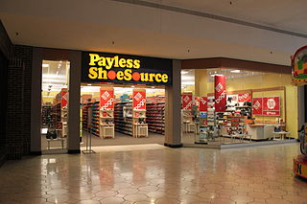
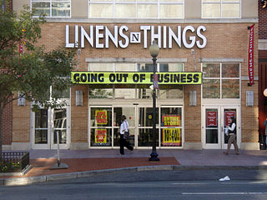
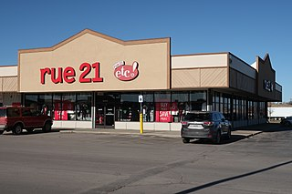
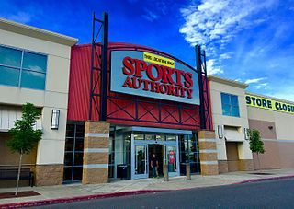
1990 - 2019
Photos by Flickr Photo / Laura Northrup, Dwight Burdette, Mr. Satterly, Kingofthedead, and Daniel Lobo

Slide 29
1990 - 2019
Causes of the retail apocalypse.
Retail was overbuilt
Leveraged Buy Outs/Debt
Getting Stale or no longer competitive
New Technology – IPODS, E-Readers, Streaming, ETC.

Slide 30
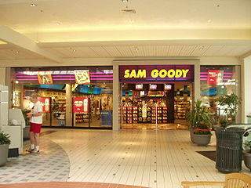
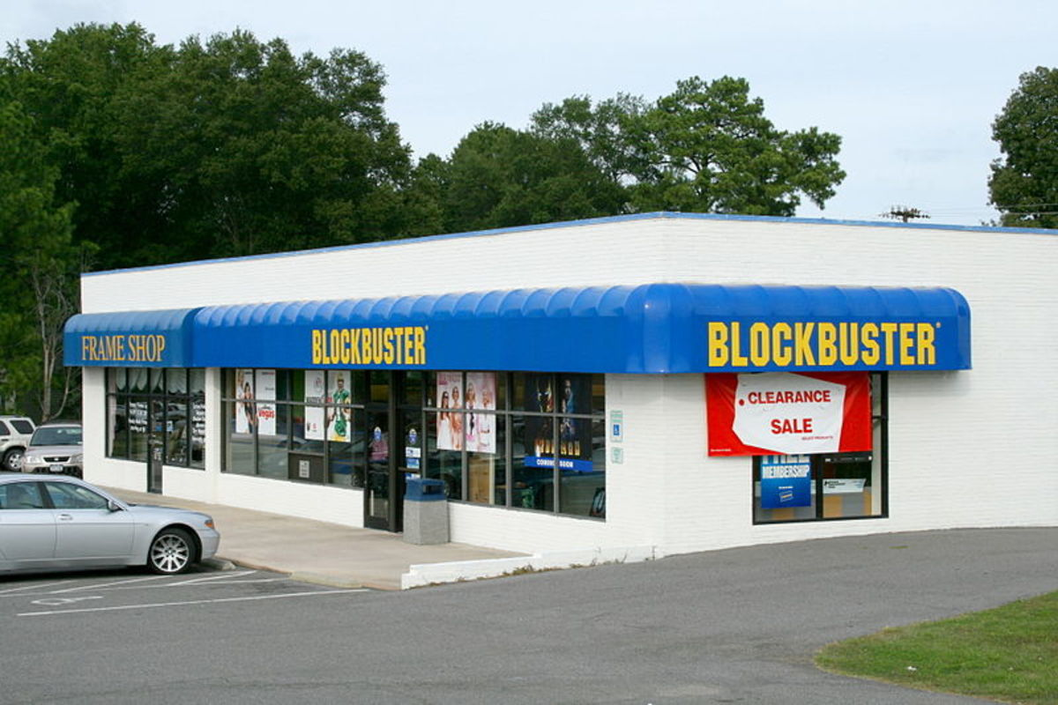
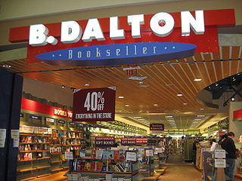
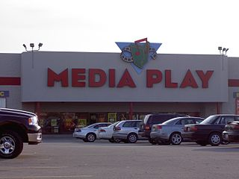
1990 - 2019
Photo byIldar Sagdejev (Specious), Adam Lautenbach, Punkrawker4783, Ente75

Slide 31
1990 - 2019
Causes of the retail apocalypse.
Retail was overbuilt
Leveraged Buy Outs/Debt
Getting Stale or no longer competitive
New Technology – IPODS, E-Readers, ETC.
Experience Economy

Slide 32
1990 - 2019
Causes of the retail apocalypse beyond on-line shopping
Retail was overbuilt
Leveraged Buy Outs/Debt
Getting Stale or no longer competitive
New Technology – IPODS, E-Readers, ETC.
Experience Economy
In-Store Customer Experience

Slide 33
The Winners and Losers 2017
Losers
Rue21
Sears/K-Mart
Payless Shoe Source
Walgreens
Radio Shack
Total Store Closings: 14,404
2019: 8,428
Winners
5. TJ MAXX
Autozone
Aldi
2. Dollar Tree
Dollar General
Total Store Openings: 18,532
2019: 11,393

Slide 34
The COVID Crisis and retail
Photo from Foko Retail

Slide 35
The Future ----
What do we know about the future – Nothing
Professor Ethan Seltzer – Portland State University

Slide 36
Looking ahead
What to expect:
Budget retailers dominate new chain construction.
Generation Z
Locally owned retailers growing.
On line moving to bricks and mortar? – blurring the lines?
Do malls have a future?
The End of Black Friday?

Slide 37
Contact Information
John Dornoff
John.dornoff@waterloo-ia.org
319-291-4366

Slide 38
References
Works Cited
Ault, Ben Unglesbee and Nicole. “Is the Road to Bankruptcy Paved by Private Equity?” Retail Dive, 9 Nov. 2018, www.retaildive.com/news/the-road-to-bankruptcy/540617/.
Department, Published by Statista Research, and Sep 3. “Retail Stores: Openings and Closures U.S. 2017-2019.” Statista, 3 Sept. 2020, www.statista.com/statistics/757160/retail-store-opening-closing/.
Fuller, Jennifer Mann. “Closings Highlight Retail Woes Excess Stores Trigger Shakeout In Overbuilt U.S. Retail Industry.” Spokesman-Review, 27 July 1997.

