Slide 1
Should Comprehensive Planning Really be
COMPREHENSIVE?
Upper Midwest Planning Conference
October 13, 2020
Notes:
Mindy –

Slide 2
Agenda
Introductions & Experience
Issues with Comprehensive Planning
User Opinions - survey
State Statutes
Why do we plan? - survey
Ideas for further study
Notes:
Mindy –
Today we’re going to talk about some of the issues that we've encountered with planning and then take a step back to see if we should approach planning in a different way to mitigate some of those issues.
We don’t have a solution, but hope to open the door for further discussion and if there are any students in the audience today, maybe there’s an idea here that you can pick up on for further research. WE do want to have a discussion at the end, so please think of your comments and go ahead and type them in the chat.

Slide 3
Presenters
Jared Foss
Mindy Moore
Charlie Dissell
Lorin Ditzler
Notes:
Mindy
20 years of experience – the last 6 years at Snyder, worked on 4 comp plans for Iowa clients (plus strategic plan, bike plans, pedestrian plans, trail plans)
Prior to that – in the public sector
In Des Moines, worked on bike master plan, park plans
In Deerfield Beach, FL, updated city’s comp plan
In Peoria County, IL, worked on small town plan
Jared
At Snyder, worked on 4 comp plans for Iowa clients (bike plans, pedestrian plans, trail plans)
At Region XII COG, worked on 2 small town comp plans

Slide 4
Economics
Collaboration
Housing
Utilities
Sustainability & Resilience
Food Systems
Demographics
Infrastructure
History
Education
Parks
Climate Change
Equity
Health
Hazard Mitigation
Transportation
Land Use
Art
Community Character
Notes:
Lorin –
In recent years, Comprehensive Plans have become more.... well, comprehensive. Traditional Comprehensive Plans of yore included topics such as land use, economic, housing, and transportation. Now they also include additional topics such as [click] collaboration, community character, and possibly climate change and equity issues, even art and food systems. Planning really can be used to address nearly everything that impacts a community.

Slide 5
More topics & engagement
Higher Costs
Too overwhelming
Notes:
Lorin –
And when we expand the number of topics that we cover, our engagement efforts also have to expand.
We have worked on a number comprehensive plans and has found that creating a truly COMPREHENSIVE plan requires more time and collaboration than many communities are able to fund and results in plans that are too overwhelming for busy local government staff.

Slide 6
What issues have we encountered?
Confusing to general public
Format doesn’t always work well for small towns
Desire for more graphics vs text
Too many goals, objectives, actions/policies
Intergovernmental and public/private collaboration obstacles
Lack of involvement by all gov’t departments
Notes:
Lorin 1st…
Jared -
Size of the community matters
Accurate scope and education/Planning experience
Evolving formats (PDF, Story Maps, Graphics, less text
Age of the previous plan (what to keep/not keep)
Charlie -
Mindy – last…
Public engagement has evolved
Social media – easier, but more competition
Increased awareness of obstacles
More graphics, less text
Scope creep…
Public engagement expectations
Plans to recommend plans

Slide 7
Quick Survey - Demographics
53 responses
Most (83%) had a plan that was less than 5 years old
Most (58%) had both written and used a comp plan
Only 6% said neither
83% were planners
Place of employment
51% city
22% consultants
12% county
Excellent cross section of years of experience
Size of Community
Notes:
Mindy – Because of what we were experiencing with planning, we wondered if other planners were having similar issues. We developed this quick survey to get an idea of how other planners and local government employees thought about these issues.
Summarize demographics

Slide 8
Is your comp plan too overwhelming?
Some plans attempt to be everything to everyone. That could lead to a lot of detail or broad brush language.
It's large but can be digested chapter by chapter based on interests
We only have a land use component.
People are trying to solve everything and the planners get tasked with making everyone happy so the thing gets sprinkled with too much stuff.
Everything just barely scratches the surface and doesn't provide enough information on the implementation of certain items.
There are so many different sections with high priority goals that it becomes difficult to locate and balance those priorities.
The plan should not be the plan to end all plans.
Notes:
Mindy –
I tried to see if the people that were saying “no” had any similar demographics, such as a lot of experience or from a similar size community…. About half of them also marked that they were representing a community over 40,000 in population, but I saw no other demographic factor, such as those with more experience, that would indicate they were more likely to say no.

Slide 9
Do you think all the elements are necessary?
Yes, but maybe not the full content. It feels like our comp plan has everyone's goals and dreams for how we work into the future but no one checks in on achieving those goals.
Notes:
Mindy - It’s possible to think the plan is overwhelming and ALSO think that everything in the plan needs to be there.

Slide 10
How often do you refer to the comp plan?
We used to tie vision and goals to our Council Agenda Items. While most items are still supported by the Plan, we have simply "gotten busy”
In general we are so short staffed and now with smaller budgets, a lot of the necessary items will never get done.
Notes:
Mindy – It was reassuring to see that these plans were NOT just sitting on the shelf. They are being used. However, some staff were finding it hard to make time for it.

Slide 11
Do other departments use the plan?
We don't have all the departments feeling they have stake in the plan... as most have their own strategic plans.
Most other Departments don't understand the Comprehensive Plan, so when asking for their goals/plans, it's difficult to help them understand when they change, we'd like them to communicate that to us, so we can be sure the Council/public supports that.
Notes:
Mindy – It was also reassuring to see that other departments were using the plan. There were a couple of comments that indicated there were some issues with involvement from other departments.

Slide 12
Most Used Plan Components?
Notes:
Mindy - On this question, respondents were asked to select the three most commonly used elements. This is the total number of times that each item was selected.

Slide 13
Should we re-think what goes into a comprehensive plan?
Should we create a new model for the comprehensive planning process?
Notes:
Jared –

Slide 14
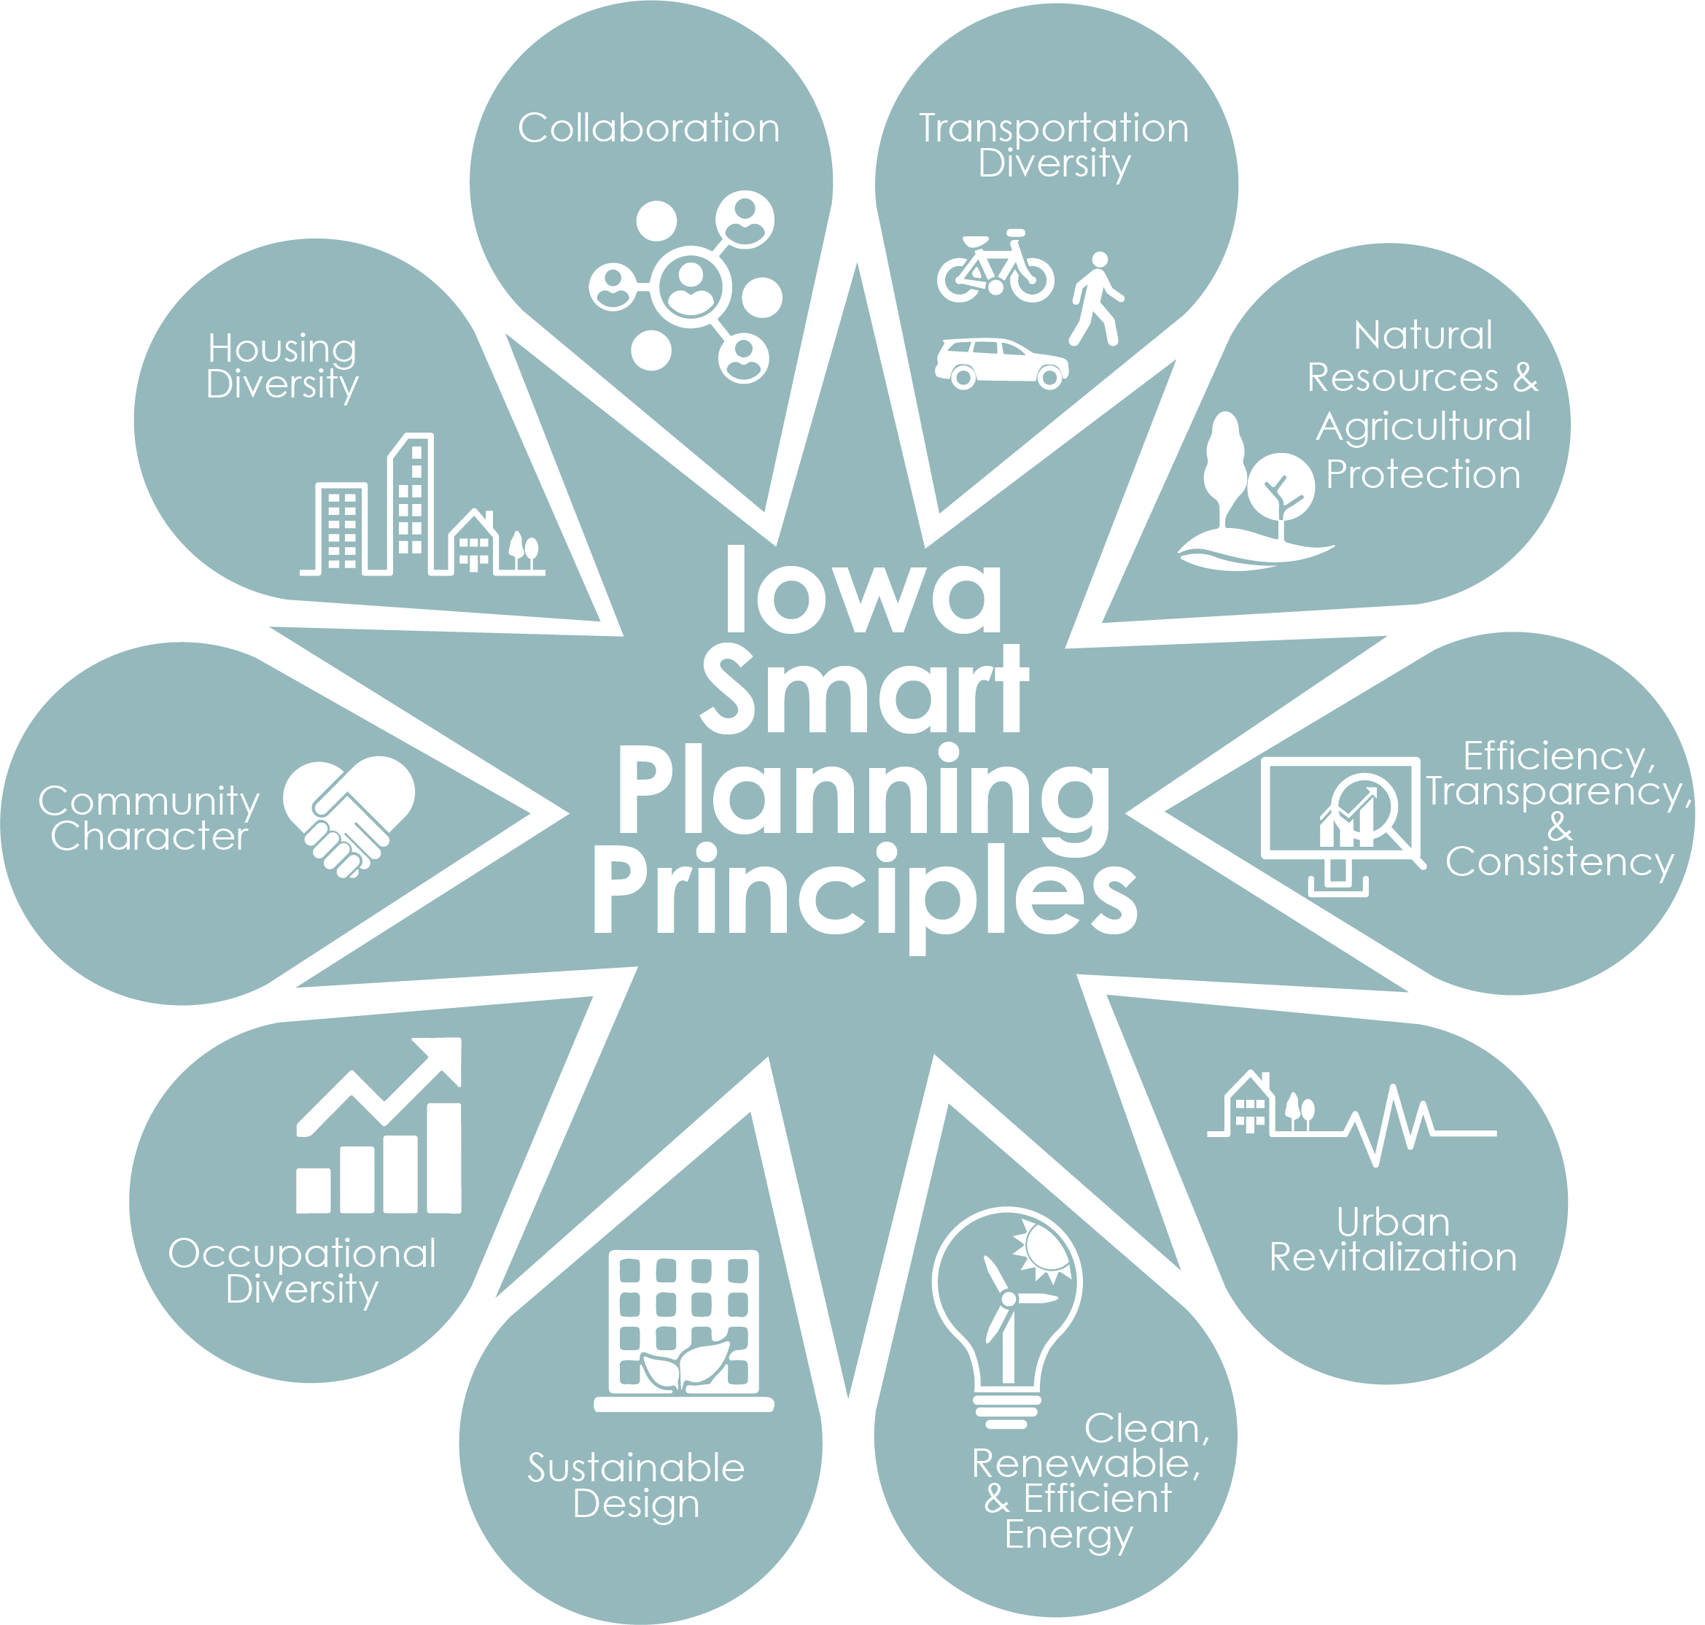
Notes:
Jared – Before we attempt to tackle those questions, let’s do a quick refresher on what is required by Code.
About 10 years ago, Iowa Planners worked hard to get these smart planning principles put in place and codified by the State.

Slide 15
State Codes
Iowa | Minnesota | Wisconsin
Public participation Primary characteristics Current land uses Established & new residential neighborhoods Utilities and community facilities Transportation system Economic development and employment opportunities Agricultural and natural resources Governmental facilities Unique qualities Natural and other hazards Intergovernmental coordination Implementation | Land use, including proposed densities Community facilities Transportation Recommendations for plan execution And in some places… Preservation of agricultural, forest, wildlife, and open space land and the minimization of development in sensitive shoreland areas. | Issues and opportunities Housing Transportation Utilities and community facilities Agricultural, natural and cultural resources Economic development Intergovernmental cooperation Land use Implementation
Notes:
Jared –
Iowa communities shall consider those smart planning principles when creating their comp plans. They do not have to address all of them in the plan. We really only need to have a land use component so that we an also have a zoning ordinance, which must be ibn accordance with the future land use.
Minnesota shall consider, but not require…
Wisconsin shall contain…

Slide 16
What’s the purpose of a Comp Plan?
Notes:
Charlie –
This brings us to the big picture question of what is the purpose of the comp plan in the first place?
On this question, respondents were given 100 stars to distribute amongst the different categories noted above based upon what they though was the most important purpose of the comp plan.

Slide 17
In the beginning the plan has to answer the question of what it intends to be... is it a physical guide, a personality guide, both. A city organization needs to define it's role and then direct the plan to serve that role.
Strategic Planning should be regularly done to ride the currents of the near term toward that longer term vision.
What is annoying though is that we have multiple [plans] and I can’t understand the difference between the comprehensive plan and strategic plan.
Often, comprehensive plans focus on a snapshot and a vision and don't address the path forward. Some are starting to include implementation sections that are a laundry list of policy, code or program changes with vague timelines and no order to accomplish.
I also think comp plans have and should evolve into less 20 year plans and more 5-10 year so as to be more actionable. This is of course also easier at the neighborhood level.
The politics often takes precedence over what proves useful. Also, while giving residents opportunity to speak is important, without political will, those voices will muddle your vision.
Notes:
Charlie (each comment comes in on a click) – Here are a few more comments from survey respondents that address the structure of the comp plan:
The first comment notes that the community can decide for itself what role the comp plan should take. And they also note that strategic, shorter term planning, needs to be done as well.
The second comment notes that having both the comp plan and strategic plans is one of the issues with planning overall… it can be confusing…
The third comment notes that often comp plans fail to show how to move forward, and when they do have a implementation section, it can still be confusing on how to manage the recommended changes.
The fourth comment notes that shorter term planning, and possibly plans that are smaller-scale in terms of geographic area, would be easier to implement. (This sounds more like strategic planning.)
And finally, someone noted that….hey, don’t forget that the “P” in “planning” stands for “politics.” The plan may be more informed by politics than by the public or even the expertise of planners or other professions.
Maybe this is where Lorin could make her point about things that get implemented are really those things that have a passionate leader pushing them forward. That can be an elected official or staff, but also can be a member of the public.

Slide 18
Discussion
How comprehensive does a comprehensive plan need to be?
How flexible?
How long-term?
How detailed should the implementation component be?
How can we make comp plans more user friendly?
How should small town plans be different than larger community plans?
Has your community done things differently?
Notes:
Charlie

Slide 19
Alternative comp plan format #1?
Vision
Future Land Use
Transportation
Housing
Parks
Health
Sustainability / Resilience
Character / Art
Utilities & Facilities
Equity
Economic Development
Hazard Mitigation
Collaboration
The Vision is informed by history, demographics, population projections, and ample public engagement.
The Comp Plan is long range, and sets goals for issues that apply to all other elements.
With the possible exception of future land use, “implementation” is not included.
The Elements become “Strategic Plans” for each topic, with implementation steps for the vision and broad goals set in the Comp Plan. They are developed with the leadership of each department and have a shorter time frame.
Notes:
Mindy - I started to think about my experiences and the comments from the survey and wanted to explore a couple of other formats for comp plans.
Who is doing this already?

Slide 20
Alternative comp plan format #2?
The Vision is informed by history, demographics, population projections, and ample public engagement.
Vision
Future Land Use
Transportation
Housing
Parks
Health
Sustainability / Resilience
Character / Art
Utilities & Facilities
Equity
Economic Development
Hazard Mitigation
Collaboration
The Comp Plan is long range, and sets goals for issues that apply to all other elements.
With the possible exception of future land use, “implementation” is not included.
The Elements set forth goals and general maps.
Downtown
Neighborhoods
Highway Corridors
Specific Districts
There are a series of geographically–specific plans that provide strategic implementation and urban design. There is targeted engagement to stakeholders in each area. These have a shorter time frame.
Notes:
Mindy –
Two ideas consistent between these two models are:
1) keep vision long range
2) allow implementation to be shorter range and specific to either a topic or a geographic area

Slide 21
Is that better?
Is that less stuff? Or the same stuff packaged differently?
Would it take longer?
Would it cost more?
Would it lead to “planning fatigue?”
Would it be more actionable? Make implementation clearer?
Does it make sense for small towns?
Notes:
Additional questions if needed:
Have you experienced push back from communities who think that something you’re trying to address in the comp plan is not the role of government?
How should we address intergovernmental collaboration? One survey comment noted that the county’s plan and the plans of the cities within the county did not always align.
How should we address goals and objectives related to entities outside the local government’s immediate control (e.g. schools, utilities, etc.)?
How do you see Covid-19 impacting future planning efforts?

Slide 22
Thank you!
Charlie Dissell, AICP cdissell@indianolaiowa.gov
Lorin Ditzler, AICP lorin@warrencountyhometown.com
Mindy Moore, AICP mmoore@snyder-associates.com
Jared Foss, AICP jfoss@snyder-associates.com

Slide 23
What’s required under Iowa law?
414.3 Regulations and comprehensive plan —
Zoning regulations shall be made in accordance with a comprehensive plan…
3. Zoning regulations and comprehensive plan shall be made with consideration of the smart planning principles under section 18B.1…
Notes:
Jared –

Slide 24
What’s required under Iowa law?
18B.2 Local comprehensive planning and development guidelines
2. A municipality shall consider the smart planning principles under section 18B.1 and may include the following information, if applicable, when developing or amending a comprehensive plan…

Slide 25
What’s suggested under Iowa law?
Public Participation
Primary characteristics
Current land uses
Established & new residential neighborhoods
Utilities and community facilities
Transportation system
Economic development and employment opportunities
Preservation and protection of agricultural and natural resources
Notes:
Information relating to public participation during the creation of the comprehensive plan....
Information relating to the primary characteristics of the municipality and a description of how each of those characteristics impacts future development of the municipality...
Objectives, information, and programs that identify current land uses within the municipality...
Objectives, policies, and programs to further the vitality and character of established residential neighborhoods and new residential neighborhoods...
Objectives, policies, and programs to guide future development of sanitary sewer service, storm water management, water supply, solid waste disposal, wastewater treatment technologies, recycling facilities, and telecommunications facilities...
Objectives, policies, and programs to guide the future development of a safe, convenient, efficient, and economical transportation system...
Objectives, policies, and programs to promote the stabilization, retention, or expansion of economic development and employment opportunities

Slide 26
What’s suggested under Iowa law?
Development of governmental facilities
Qualities that make the municipality unique...
Natural and other hazards
Programs for joint planning and joint decision making with other municipalities or governmental entities,
A compilation of programs and specific actions necessary to implement any provision of the comprehensive plan...
Notes:
Objectives, policies, and programs addressing preservation and protection of agricultural and natural resources...
Objectives, policies, and programs to assist future development of educational facilities, cemeteries, health care facilities, child care facilities, law enforcement and fire protection facilities, libraries, and other governmental facilities that are necessary or desirable to meet the projected needs of the municipality...
Objectives, policies, and programs to identify characteristics and qualities that make the municipality unique...
Objectives, policies, and programs that identify the natural and other hazards that have the greatest likelihood of impacting the municipality or that pose a risk of catastrophic damage as such hazards relate to land use and development decisions...
Objectives, policies, and programs for joint planning and joint decision making with other municipalities or governmental entities, including school districts and drainage districts, for siting and constructing public facilities and sharing public services...
A compilation of programs and specific actions necessary to implement any provision of the comprehensive plan...

Slide 27
What’s required under Minnesota law?
462.352 Subd5. “Comprehensive municipal plan" means a compilation of policy statements, goals, standards, and maps for guiding the physical, social and economic development, both private and public, of the municipality and its environs, and may include, but is not limited to, the following:
statements of policies, goals, standards,
a land use plan, including proposed densities for development,
a community facilities plan,
a transportation plan, and
recommendations for plan execution.
Notes:
Objectives, policies, and programs addressing preservation and protection of agricultural and natural resources...
Objectives, policies, and programs to assist future development of educational facilities, cemeteries, health care facilities, child care facilities, law enforcement and fire protection facilities, libraries, and other governmental facilities that are necessary or desirable to meet the projected needs of the municipality...
Objectives, policies, and programs to identify characteristics and qualities that make the municipality unique...
Objectives, policies, and programs that identify the natural and other hazards that have the greatest likelihood of impacting the municipality or that pose a risk of catastrophic damage as such hazards relate to land use and development decisions...
Objectives, policies, and programs for joint planning and joint decision making with other municipalities or governmental entities, including school districts and drainage districts, for siting and constructing public facilities and sharing public services...
A compilation of programs and specific actions necessary to implement any provision of the comprehensive plan...

Slide 28
What’s required under Minnesota law?
462.357 Subd1h. When adopting or updating a comprehensive plan in a municipality located within a county that is not a greater than 80 percent area, as defined in section 103G.005, subdivision 10b, and that is located outside the metropolitan area, as defined by section 473.121, subdivision 2, the municipality shall consider adopting goals and objectives for the
preservation of agricultural, forest, wildlife, and open space land and the minimization of development in sensitive shoreland areas.
Within three years…, the municipality shall consider adopting ordinances as part of the… controls that encourage the implementation of the goals and objectives.

Slide 29
What’s required under Wisconsin law?
66-1001 (2) A comprehensive plan shall contain all of the following elements:
Issues and opportunities
Housing
Transportation
Utilities and community facilities
Agricultural, natural and cultural resources
Economic development
Intergovernmental cooperation
Land use
Implementation

Slide 30
What’s required under Wisconsin law?
66-1001 (3) Ordinances that must be consistent with the comprehensive plan:
Official mapping
Local subdivision
County zoning
City, town or village zoning
Shoreland or wetland zoning

Slide 31
Learning Objective
Code Requirements for Comprehensive Plans and discuss need for change
1
Learning Objective
Explore content necessary for a 20 year comprehensive plan
2
Learning Objective
Explore whether all the traditional approaches to comprehensive planning should be revisited
3

