Slide 1



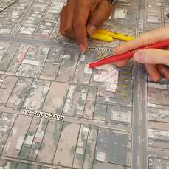



Ethics Cases of the Year: 2020
Prepared by the Ethics Committee of the American Institute of Certified Planners
2020 Upper Midwest APA Planning Conference
October 14, 2020

Slide 2
Moderators
Charles Connerly, Ph.D.
Professor & DEO,
School of Planning & Public Affairs
University of Iowa
Jerry Anthony, Ph.D., FAICP
Associate Professor
School of Planning & Public Affairs
University of Iowa

Slide 3

Agenda
Refresher on Planning Ethics
Ethical Scenarios
  Confidential Information
  Professional Misrepresentation
  Personal Property
  Social Equity
  Virtual Public Engagement
  Endorsements
  Elected Office
The Compliance and Ethics Blog

Slide 4
Disclaimer
This session has been created to provide general education regarding the AICP Code of Ethics.
Although ethical scenarios and question-and-answer sessions are an important part of illustrating the application of the Code’s provisions, all certified planners should be aware that only the AICP Ethics Committee is authorized to give formal advice on the propriety of a planner’s proposed conduct.
If you have a question regarding a situation in your own professional practice, you are encouraged to seek informal advice from the AICP Ethics Officer (ph: 312-786-6360; email: ethics@planning.org).
This AICP Ethics Code certificate is available for downloading from planning.org/ethics. (See https://planning-org-uploaded-media.s3.amazonaws.com/document/AICP-Code-of-Ethics-Certificate_Updated.pdf)

Slide 5
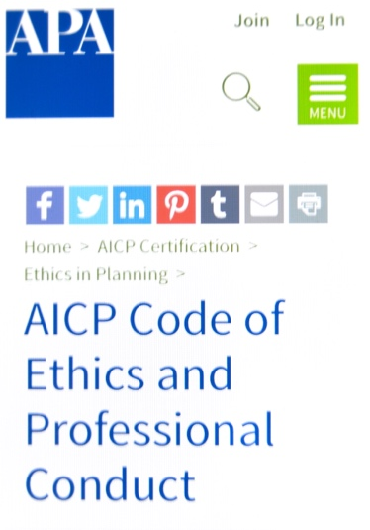
AICP’s Code of Ethics
Adopted in 1948 by the American Institute of Planners; rev. 1959, 1970, 1978, 1991, 2005, and 2016
A. Aspirational Principles
Responsibility to: the Public, Clients/Employees, and Profession/Colleagues
B. Rules of Conduct
Twenty-six Rules to which AICP members are held accountable
C. Advisory Opinions
Informal Advice, Formal Advisory Opinions, Annual Report
D. Complaints of Misconduct
Filings, Preliminary Charge/Dismissal, Settlement, Decision, Appeal
E. Discipline of Members
Confidential Letter, Public Censure, Suspension, Revocation

Slide 6
APA’s Ethical Principles in Planning
Adopted in 1980 by the American Planning Association; revised in 1992
Guidelines for advisors, advocates, and decision makers in the planning process
1. Serve the public interest
Provide accurate information, provide opportunity for all, protect natural and built environment, pay attention to long-range consequences of action, etc.
2. Maintain high standards of integrity and proficiency
Provide independent judgement, disclose personal interests, seek no gifts or favors, avoid conflicts of interest, don’t disclose confidential information, don’t misrepresent facts, respect rights of all persons, etc.
3. Improve planning competence
Provide high level of professionalism, commit no wrongful acts, contribute time for groups lacking planning resources, treat other professionals fairly, etc.

Slide 7

Ethical Misconduct Cases in 2019(19 total)
Seven Cases Dismissed
No preliminary charges filed
Two Cases Dismissed
After preliminary charges are filed
Ten Cases Settled
Eight of 10 for misuse of AICP credential
Two Disciplinary Actions
Confidential Letters of Admonition
Disclosure of confidential information (Rule of Conduct #7)
Secondary employment and special advantage (Rules of Conduct #4, #5, and #14)
Carol Hu; APA Image Library

Slide 8
Ethics Topics in 2019
Based on misconduct cases and informal inquiries
The most commonly-cited Rules of Conduct were: #1 (accurate information) and #7 (confidential information)

Slide 9
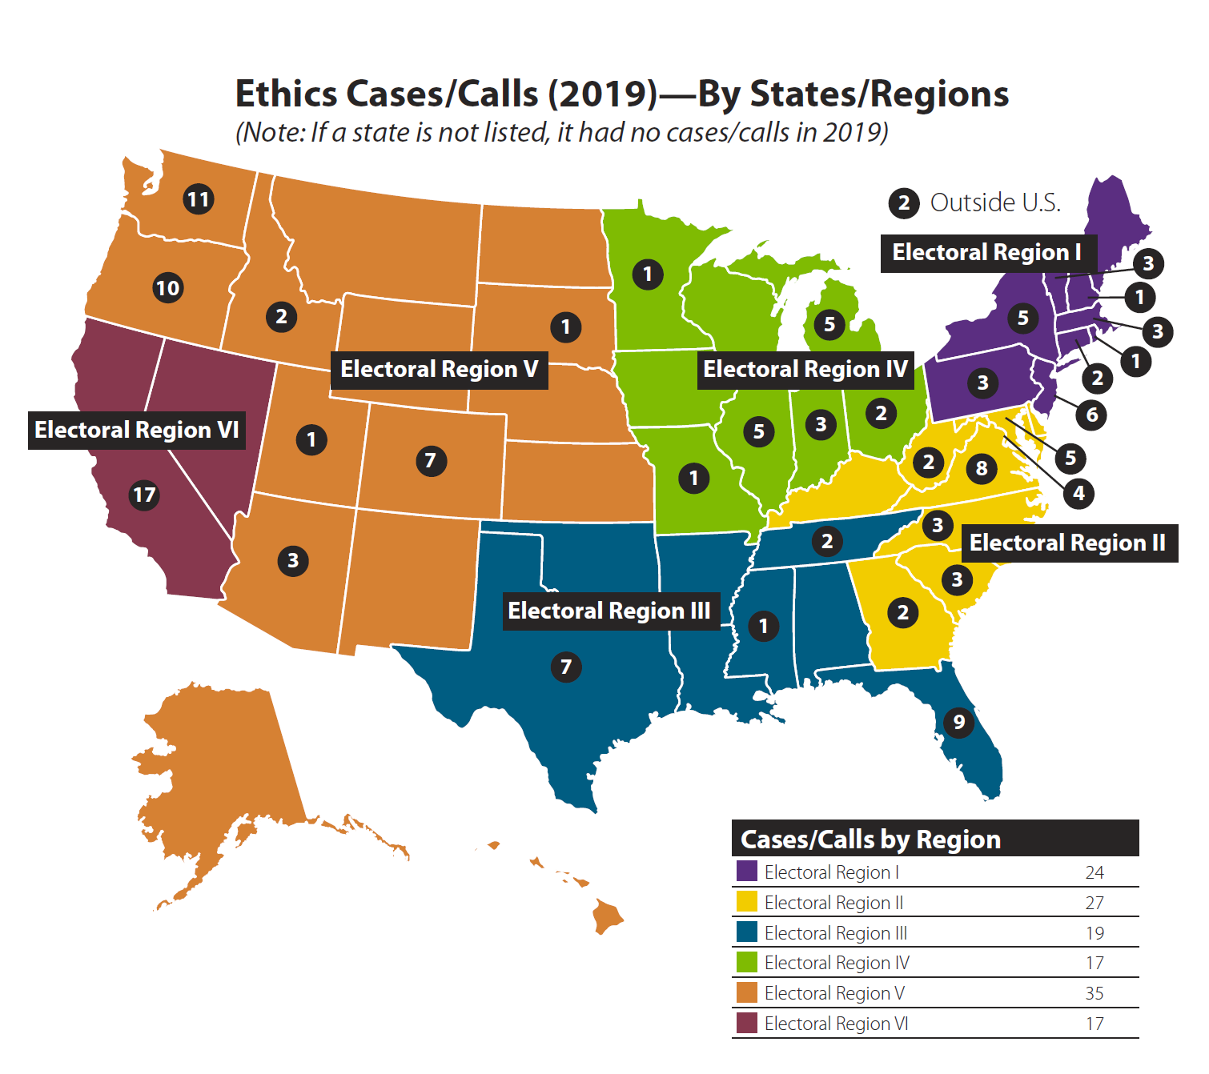
Cases of the Year
The following ethical scenarios are largely based on real-life situations from 2019 and early 2020, although the names and locations are fictional.
These scenarios were derived from informal inquiries or misconduct complaints reviewed by the Ethics Officer and the Ethics Committee.

Slide 10

Cast of Characters
Consultant
Jane, aicp
Planning Director
Lucio, aicp
Small Town Planner
Catherine, aicp
Elected Official
Marcy
Staff Planner
Norman, aicp

Slide 11

Scenario 1
Confidential Information
Marcy, a restaurant owner—and member of the Costaville city council—sends an email to Lucio, AICP, the planning director, inquiring about the process for conditional use permits. She's concerned about a pet grooming store opening next door to her restaurant.
Lucio tells the pet store owner about Marcy's email and, the next time the owner sees Marcy, he yells at her and accuses her of trying to stop the project.
Learning Mind

Slide 12

Scenario 1 (contd.)
When Marcy asks Lucio why he told the owner about her email, he says that because she is an elected official this information was public.
Marcy notes that she had inquired on her restaurant email—and not from her city council email. Further, she notes, the owner had not made any FOIA request for the emails.
She says comments made by the pet store owner have had a negative impact on her business.
Marcy
Lucio
lionIT

Slide 13
Scenario 1
Questions
Q 1.1:
Was Lucio correct in disclosing this information to the applicant?
Yes
No
Not Sure

Slide 14
Scenario 1
Questions (contd.)
Q 1.2:
Did Lucio violate the AICP Ethics Code in disclosing this information?
Yes
No
Not Sure

Slide 15
Scenario 1
Ethical Issues
AICP Ethics Code “Aspirational Principles”
1a: We shall always be conscious of the rights of others.
1b: We shall have special concerns for the long-range consequences of present actions.
1h: We shall deal fairly [evenhandedly] with all participants in the planning process.
AICP Ethics Code “Rules of Conduct”
#7: We shall not use to our personal advantage…information gained in a professional relationship that the client or employee has requested be held inviolate or that we should recognize as confidential because its disclosure could result in embarrassment or other detriment to the client or employer….
Notes:
In the real case, on which this scenario was based, the AICP Ethics Officer and the AICP Ethics Committee agreed that Lucio should not have disclosed this information. He received a Confidential Letter of Admonition and the case was closed.

Slide 16
Scenario 1
Outcomes
In the real-life case, on which this scenario was based, the Ethics Officer and the AICP Ethics Committee both agreed that Lucio should not have disclosed this information.
By doing so, they said, Lucio had caused embarassment to Marcy. Thus, it was a violation of Rule of Conduct #7 (confidential information).
Lucio received a Confidential Letter of Admonition and the case was closed.
Lucio
Marcy
Legaltranscriptionservice.com

Slide 17

Scenario 2
Professional Misrepresentation
Jane, AICP, a consultant, learns that Lucio, AICP, Costaville’s planning director, is blaming Jane for the recent defeat by city council of a subarea plan she worked on. In a meeting, Lucio tells the Mayor that Jane’s firm never should be hired again.
Jane hears this from Norman, AICP, who knows the plan’s failure was due to Lucio’s poor political skills. Norman, who works for Lucio, was in the meeting.
Witbanknews.co.za

Slide 18

Scenario 2 (contd.)
Because Costaville has been a major client of Jane’s firm, Lucio’s statement to the Mayor will have a major impact. Jane decides to file a complaint of ethical misconduct against Lucio, citing a violation of Rule #10 in the AICP Ethics Code.
Unfortunately, there is no proof of what Lucio said to the Mayor and, because Norman, AICP, says he can not step forward to attest to what was said in the meeting, the complaint is dismissed.
Norman
Jane
Lucio
Matt Norman
Notes:
Rule #10 of the AICP Code says: “We shall neither deliberately, nor with reckless indifference, misrepresent the qualifications, views, and findings of other professionals.”

Slide 19
Scenario 2
Questions
Q 2.1:
Did Jane have a good basis to file an ethics misconduct complaint against Lucio?
Yes
No
Not Sure

Slide 20
Scenario 2
Questions (contd.)
Q 2.2:
Did Norman have an obligation to cooperate with the investigation and testify to what he heard in the meeting?
Yes
No
Not Sure

Slide 21
Scenario 2
Ethical Issues
AICP Ethics Code “Aspirational Principles”
3c: We shall describe and comment on the work and views of other professionals in a fair and professional manner.
AICP Ethics Code “Rules of Conduct”
#10: We shall neither deliberately, nor with reckless indifference, misrepresent qualifications, views, and findings of other professionals.
#21: We shall not withhold cooperation or information from the AICP Ethics Officer or the AICP Ethics Committee if a charge of ethical misconduct has been filed against us.

Slide 22
Scenario 2
Outcomes
In the real-life case, on which this scenario was based, no one in the meeting (including at least one AICP member) was willing to corroborate the allegation to the Ethics Officer—even with a promise of confidentiality.
Consequently, after several months, the misconduct complaint was dismissed due to lack of evidence.
Witbank News

Slide 23
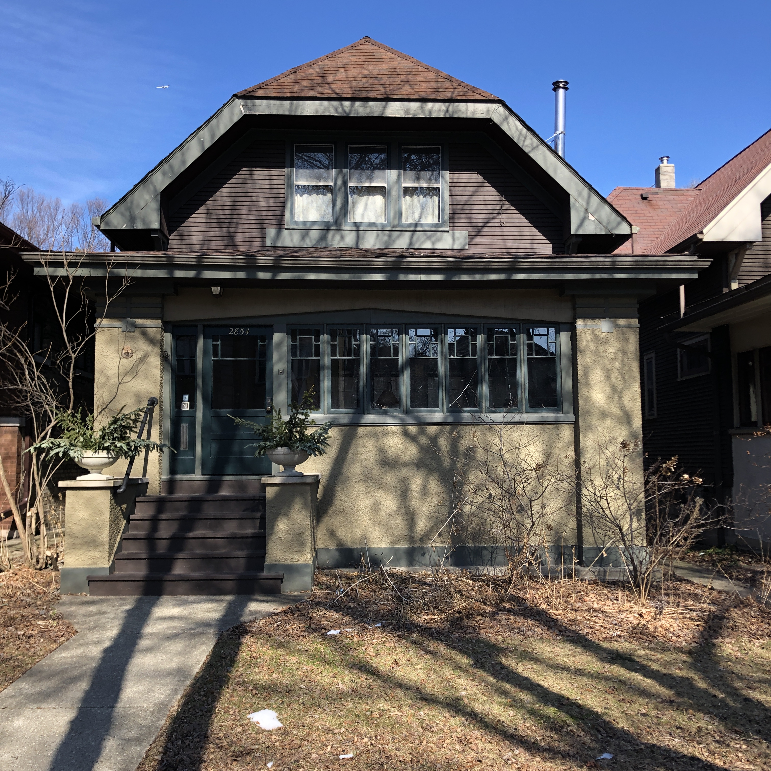
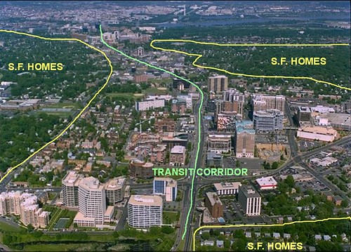
Scenario 3a
Personal Property
Norman, AICP, a staff planner with Costaville, is working on a rezoning proposal for a transit-oriented development (TOD) corridor, in accordance with a new subarea plan.
A member of the public tells Norman he has a conflict of interest since he lives two blocks from the TOD corridor—and the rezoning could increase the value of his own house.
mapei

Slide 24
Scenario 3a (contd.)
Norman asks his supervisor, Lucio, AICP, if another staff planner could work on the project, given the proximity of the proposed TOD district to Norman’s house.
Lucio tells Norman that, due to staff constraints, he needs to work on the project. But, he says, Norman should disclose this potential conflict of interest at all public meetings.
Ryan Scherzinger, AICP; APA Image Library

Slide 25
Scenario 3a
Questions
Q 3.1:
Have both planners behaved in accordance with the AICP Ethics Code?
Yes
No
Not Sure

Slide 26
Scenario 3a
Questions (contd.)
Q 3.2:
Do you agree with the decision of Lucio, Norman’s supervisor?
Yes
No
Not Sure

Slide 27

Scenario 3b
Personal Property
Catherine, AICP, is the only planner for Bauerville, a small ski town. Her town manager has asked her to develop guidelines for vacation rentals, based on a growing number of complaints from community residents.
Catherine has owned a second home in Bauerville for the past five years, which she often rents out on Airbnb or VRBO.
Catherine
Sunset magazine

Slide 28
Scenario 3b
Questions
Q 3.3:
Should Catherine work on this project?
Yes
No
Not Sure
Notes:
Catherine should notify her supervisor of the conflict and, if another solution can’t be found, get permission in writing to work on this. She also needs to disclose this potential conflict in all public meetings where it’s discussed.

Slide 29
Scenario 3b
Questions (contd.)
Q 3.4:
If “no,” how should Catherine handle this request?
a) Suggest hiring a consultant
b) Ask county planning department to assist
c) Other

Slide 30
Scenario 3
Ethical Issues
AICP Ethics Code “Aspirational Principles”
2c: We shall avoid a conflict of interest or even the appearance of a conflict of interest in accepting assignments from clients or employers.
AICP Ethics Code “Rules of Conduct”
#6: We shall not perform work on a project if…there is a possibility for direct personal or financial gain to us…unless our client or employer, after full written disclosure from us, consents in writing to the arrangement.
#14: We shall not use the power of any office to seek or obtain a special advantage that is not a matter of public knowledge or is not in the public interest.

Slide 31
Scenario 3
Outcomes
In the two real-life cases, on which these scenarios were based:
After being charged with misconduct—based on a complaint by a resident—Norman provided evidence to the Ethics Officer that he had, in advance, notified his supervisor, Lucio, of the potential conflict of interest. Lucio then had told him to: 1) continue to work on the project and 2) fully disclose his ownership interests at all public meetings. Subsequently, the misconduct charge was dismissed.
Catherine was still trying to decide how best to handle her vacation rental issue, since the town did not have the resources to hire a consultant. However, she was planning to disclose her property ownership, in writing, to both her supervisor and the Plan Commission.
Norman
Lucio
Catherine

Slide 32
Scenario 4
Social Equity
Norman, AICP, a staff planner with Costaville, has been assigned to review the site plan for a group home for refugee immigrant children who have been separated from their parents.
The site plan meets all legal requirements, but Norman is concerned about the quality of the operation, as well as the long-term separation of the children from their parents.
Gabriel Hongsdusit/Reveal

Slide 33

Scenario 4 (contd.)
Norman voices these concerns to his supervisor, Lucio, AICP, who says he is very sympathetic. But Lucio notes that the Mayor wants to get the approval done as fast as possible—”before the NIMBYs get wind of this,” says the Mayor.
Lucio tells Norman to focus just on the facts of the site plan review process in his staff report—and not to mention any of his social equity concerns.
Norman
Lucio
David J. Phillip/The Intercept

Slide 34
Scenario 4
Questions
Q 4.1:
Is Lucio correct, ethically, to tell Norman to only focus the staff report on the facts relevant to the site plan review?
Yes
No
Not Sure

Slide 35
Scenario 4
Questions (contd.)
Q 4.2:
Is there anything else Norman should do or say?
a) Speak directly to the Mayor
b) Investigate what other communities have done
c) Leak the story to the media
d) Other

Slide 36
Scenario 4
Ethical Issues
AICP Ethics Code “Aspirational Principles”
1f: We shall seek social justice by working to expand choice and opportunity for all persons, recognizing a special responsibility to plan for the needs of the disadvantaged and to promote racial and economic integration. We shall urge the alteration of policies, institutions, and decisions that oppose such needs.
2b: We shall accept the decision of our client or employer…unless the course of action is illegal or plainly inconsistent with our primary obligation to public interest.
3e: We…shall not accept the applicability of a customary solution without first establishing its appropriateness to the situation.

Slide 37
Scenario 4 (contd.)
AICP Ethics Code “Rules of Conduct”
#1: We shall not deliberately or with reckless indifference fail to provide adequate, timely, clear and accurate information on planning issues.
#2: We shall not accept an assignment from a client or employer when the services to be performed involve conduct we know to be illegal or in violation of these rules.
#18: We shall not direct or coerce other professionals to make analyses or reach findings not supported by available evidence.

Slide 38
Scenario 4
Outcomes
In the real-life case, on which this scenario was based, Norman and Lucio were seeking background information from other communities that had dealt with this group home operator.
Meanwhile, a local community group was raising its own social concerns about the project in public meetings, media stories, and social media posts.
Gabriel Hongsducit/Reveal

Slide 39
Scenario 5
Virtual Public Engagement
During the recent viral pandemic, Costaville moved its public meetings to web-based platforms, where public engagement was handled through online forums and chat rooms.
With continued concerns about face-to-face interactions, the Mayor has told his planning director, Lucio, AICP, to use a similar technology for an upcoming Subarea Plan workshop.
Ryan Johnson for the Washington Post

Slide 40
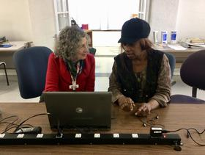
Scenario 5 (contd.)
Lucio tells the Mayor this will exclude many residents who don’t have access to—or proficiency with– computers. Also, some residents won’t be able to access the draft documents. Finally, Lucio says, many of these same people have concerns about affordable housing, which is a key element of the draft plan.
Lucio suggests delaying the plan until an in-person workshop can be held. The Mayor, however, fearing the loss of state funding for the plan, orders him to go ahead with the virtual public workshop.
Lucio
Connecting for Good

Slide 41
Scenario 5
Questions
Q 5.1:
Should Lucio obey the Mayor and schedule the virtual workshop?
Yes
No
Not Sure

Slide 42
Scenario 5
Questions (contd.)
Q 5.2:
What is the key ethical issue facing Lucio, as relating to the AICP Ethics Code?
To accept his employer’s decision
To delay the workshop
To explore other public engagement options
Other

Slide 43
Scenario 5
Ethical Issues
AICP Ethics Code “Aspirational Principles”
1d: “We shall provide timely, adequate, clear, and accurate information on planning issues to all affected persons and to government decision makers.”
1e: We shall give people the opportunity to have a meaningful impact on the development of plans and programs that may affect them. Participation should be broad enough to include those who lack formal organization or influence.”
1f: “We shall seek social justice by working to expand choice and opportunity for all persons, recognizing a special responsibility to plan for the needs of the disadvantaged and to promote racial and economic integration. We shall urge the alteration of policies, institutions, and decisions that oppose such needs.”
2b: “We shall accept the decisions of our client and employer…unless the course of action is illegal or plainly inconsistent with our primary obligation to the public interest.”

Slide 44
Scenario 5
Ethical Issues (contd.)
AICP Ethics Code “Rules of Conduct”
#1: “We shall not deliberately or with reckless indifference fail to provide adequate, timely, clear, and accurate information on planning issues.”
#18: “We shall not direct or coerce other professionals to make analyses or reach findings not supported by available evidence.”
#20: “We shall not unlawfully discriminate against another person.”

Slide 45

Scenario 5
Outcomes
This scenario, which was written early on during the Covid-19 global pandemic, was not based on a real-life situation.
However, at least one community is facing a lawsuit by a group of residents who say they were not able to participate in a Plan Commission meeting on a controversial project during the pandemic—due to their lack of internet access.
New Westminster

Slide 46

Scenario 6
Endorsements
Jane, AICP, a planning consultant, asks if Catherine, AICP, a planner with Bauerville, is willing to be interviewed about the town’s award-winning comprehensive plan, which Jane’s firm worked on.
The interview will be handled by a PR firm who has been hired to prepare a promotional video for the consulting firm.
Catherine
AlabamaToday.com

Slide 47


Scenario 6 (contd.)
That same week, a company who is building a new water park in Bauerville—whose site plan Catherine reviewed and approved—asks if she could write a separate approval letter.
When Catherine asks why, the owners say they would like to use this letter when dealing with other public jurisdictions.
Lawcrossing.com
Coconut Bay Resort

Slide 48
Scenario 6
Questions
Q 6.1:
Should Catherine agree to be interviewed for the promotional video?
Yes
No
Not Sure

Slide 49
Scenario 6
Questions (contd.)
Q 6.2:
Should Catherine agree to write a letter of recommendation for the water park operator?
Yes
No
Not Sure

Slide 50
Scenario 6
Ethical Issues
AICP Ethics Code “Aspirational Principles”
1c: We shall pay special attention to the interrelatedness of decisions.
2c: We shall avoid a conflict of interest or even the appearance of a conflict of interest in accepting assignments from clients or employers.
AICP Ethics Code “Rules of Conduct”
#14: We shall not use the power of any office to seek or obtain a special advantage that is not a matter of public knowledge or is not in the public interest.

Slide 51
Scenario 6
Outcomes
In the two real-life cases, on which these scenarios were based:
Catherine decided not to participate in the interview, but suggested that the PR firm should contact the Mayor for a comment.
Catherine decided not to write the separate approval letter, suggesting to the developer that the formal approval permit was sufficient proof of compliance.
Catherine
Alabama Today.com

Slide 52
Scenario 7
Elected Office
Catherine, AICP, a planner with Bauerville, would like to run for city council in Wurster, where she resides.
In accordance with the AICP Ethics Code (Rule #4), she requests written permission from her town manager. But the manager is hesitant, noting that both the ICMA’s Ethics Code and the AICP Ethics Code discourage such political activities.
Catherine
Medium
Notes:
Rule #4 of AICP Ethics Code: “We shall not, as salaried employees, undertake other employment in planning or a related profession, whether or not for pay, without having made full written disclosure to the employer who furnishes our salary and having received subsequent written permission to undertake additional employment, unless our employer has a written policy which expressly dispenses with a need to obtain such consent.”

Slide 53

Scenario 7
Questions
Q 7.1:
Is the town manager correct? Does the AICP Ethics Code recommend that certified planners not run for elected office?
Yes
No
Not Sure

Slide 54
Scenario 7
Questions (contd.)
Q 7.2:
If Catherine does run for City Council, what ethical concerns should she have?
Conflicts involving the community where she works
Perceptual conflicts involving the community
Gifts and other benefits
All of the above

Slide 55
Scenario 7
Ethical Issues
ICMA Ethics Code “Guidelines”
7c: Members shall not run for elected office or become involved in political activities related to running for elected office or accept appointment to an elected office.
AICP Ethics Code “Aspirational Principles”
3j: We shall contribute time and effort to groups lacking in adequate planning resources and to voluntary professional activities.
AICP Ethics Code “Rules of Conduct”
#4: We shall not…undertake other employment in planning or a related profession, whether or not for pay, without having made full written disclosure…and having received subsequent written permission to undertake additional employment.

Slide 56
Scenario 7
Outcomes
This scenario was based on multiple real-life cases.
In those instances where a supervisor opposed a public planner’s run for office, the planner decided not to run.
In those cases where public planners did receive written permission to run, the planners were very careful to recuse themselves from issues that could be perceived as conflicts of interest where they worked.
Medium

Slide 57

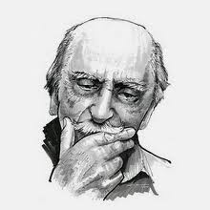
Optional Quiz
Which figures in planning history are the character names based on?
Jane
Jane Jacobs
(1916-2006)
Author, Activist, Urbanist
Lucio
Lucio Costa
(1902-98)
Architect, Planner, Preservationist
NOTE TO PRESENTER: QUIZ CONTINUED ON NEXT PAGE

Slide 58

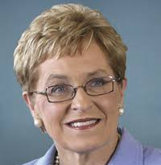
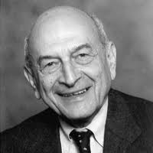
Catherine
Catherine Bauer Wurster
(1905-64)
Educator, Housing Advocate
Marcy
Marcy Kaptur
(1946 - )
Planner, U.S. Congresswoman (D-Ohio)
Norman
Norman Krumholz
(1927-2019)
Author, Educator, Planner

Slide 59
Final Note
For informal advice regarding ethical conduct, please contact the AICP Ethics Officer, Jim Peters, FAICP, at 312-786-6360 or ethics@planning.org. For more information about ethics, please visit planning.org/ethics
AICP Ethics Committee
Karen Wolf, FAICP, Chair Staron Faucher, AICP
Robert L. Barber, FAICP Valerie J. Hubbard, FAICP
Stephen C. Butler, FAICP Bonnie J. Johnson, FAICP, Ph.D.
Michelle S. Delisfort, AICP, PP

